Slide 1
Managing Digital Research Data at ANU
This work by The Australian National University is licensed under a
Creative Commons Attribution 4.0 International license

Slide 2
Housekeeping
By default your microphone and video will be disabled.
Navigate to the arrow next to your microphone and test speaker and microphone
Select to listen with your headphone or computer built in speakers
During the meeting:
Chat to All panelists
Chat to All panelists and attendees (this allows everyone to view questions being asked)
Use the Raise Hand feature to be unmuted
What happens if I drop out of the meeting?
All you need to do is to find the link you used to enter the webinar and click it again.

Slide 3
ANU Acknowledgment of Country:
We acknowledge and celebrate the First Australians on whose traditional lands we meet, and pay our respect to the elders past and present.

Slide 4
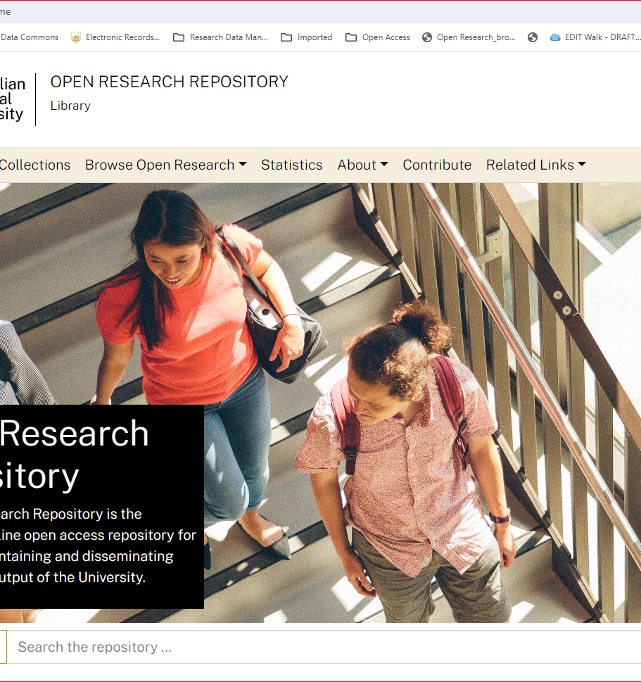
ANU Open Research Repository
Meets open access requirements for ARC/NHMRC grants
Mandated location for theses

Slide 5
ANU Research Data Management
Contents:
Definitions of Data and Data Management
Data Management Life Cycle
Benefits & Requirements
Methods of Data Management
ANU's Data Management Services
Writing a Data Management Plan

Slide 6
Digital Research Data
Any data that is created during research that can be stored on a computer.
This includes field notes and non-digital images as they can be converted to digital images
It is not:
physical data such as biological specimens, soil samples etc.
Admin data: student enrolments, assessments, research publications, course resources etc.
Electronic Records Management System (ERMS)

Slide 7
Data Management
Organisation
Bibliography Management
File transfers & remote access
Synchronisation
Collaboration
Version Control
Administration
Backups
Validation & Authentication
Documentation
Access Control
Security
Archiving
Sharing Methods
Licensing
Formats & Standards
Access Restrictions
Metadata
Archiving
FAIR Principles
Notes:
Data validation: the process of ensuring data has undergone data cleansing to ensure they are correct and useful
Data authentication: e.g. digital signature, secret keys; the act of proving the identify of a user; the process of verify the identity

Slide 8
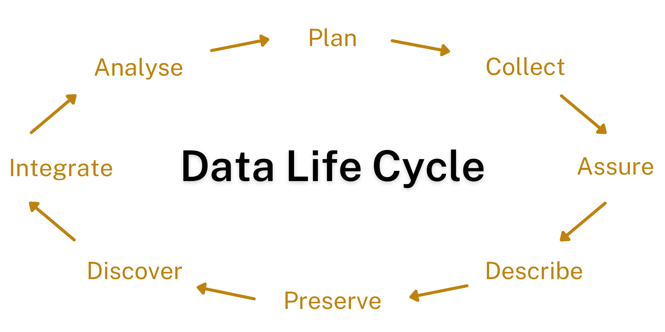
(DataOne Primer)

Slide 9
Why data management? – the future self
Work more efficiently with data
Protect data against loss or improper access
Greater exposure, enhanced reputation and prestige
Piwowar HA and Vision TJ (2013) Data reuse and the open data citation advantage. PeerJ, 1: e175. http://dx.doi.org/10.7717/peerj.175
Cousijn, H, et al. 2019. Bringing Citations and Usage Metrics Together to Make Data Count. Data Science Journal, 18: 9, pp. 1–7. DOI: https://doi.org/10.5334/dsj-2019-009
Reproducibility

Slide 10
Why data management?
ANU Policy: Responsible Conduct of Research
Comply with ethical and privacy regulations
Funding agencies
Data relating to publications must be kept for at least 5 years
Journals require sharing of data, e.g. Nature, Science, PLoS, etc.

Slide 11
Methods of Data Management
Data organisation
Bibliography management: EndNote, RefWorks, Mendeley, Zotero
Version control & file naming: TortoiseSVN, GitHub, BitBucket
File transfers: FileSender (CloudStor), OneDrive, SharePoint,
File storage: OneDrive, OneNote, ANU eNotebooks, SharePoint, NCI, ANU SafeShare
Data administration
Backups: frequency etc
access control
Data archiving and sharing
creative or science commons licenses

Slide 12
ANU's Data Management Services
Information Technology Services (ITS)
OneDrive, SharePoint
ANU Library
Statistical Support Network
Archives: Data Commons, Open Research, ADA
Supercomputer (NCI)

Slide 13
ANU Data Storage
OneDrive
OneNote
ANU eNotebooks
National Computation Infrastructure (NCI)

Slide 14
ANU Data Archives
Open Research – ANU's institutional repository. Good for publications, theses, images
ADA – Australian Data Archive. Social-science, medical, and economics datasets. Analyse datasets online with the NESSTAR webapp
Data Commons – ANU data archiving service

Slide 15
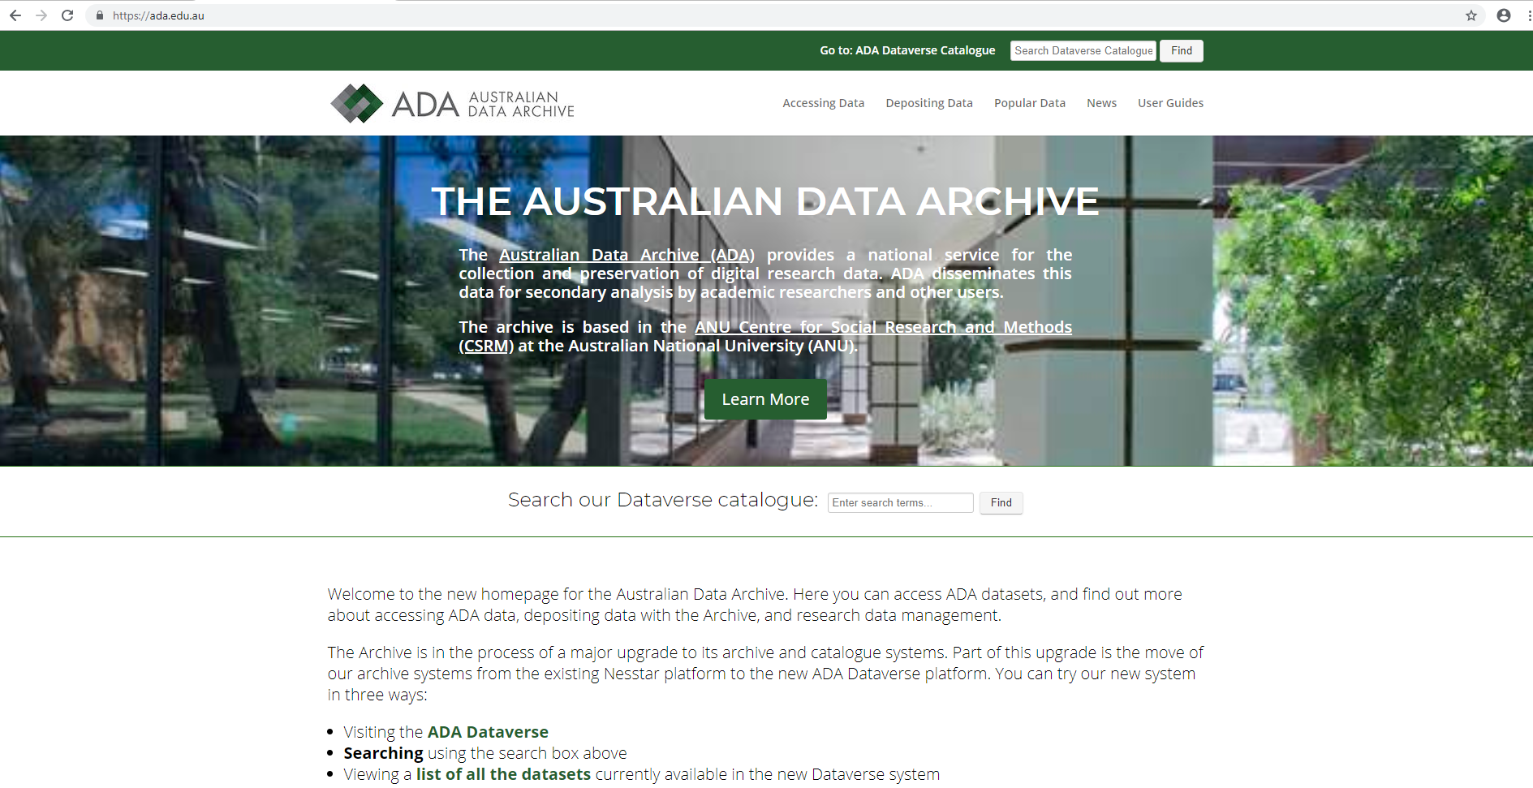
Australian Data Archive

Slide 16
ANU Data Commons
Users can deposit data for long term storage
Can mint DOIs for datasets
Users can self archive via web interface
Data can be restricted or open
Metadata can be restricted or open

Slide 17
ANU Data Commons (cont.)
As long as storage is accessible via URL, Data Commons can link to it – create a reference
Data for work in progress can be stored

Slide 18
Office 365/SharePoint
A web-based collaborative platform, available on MS Office 365, used to co-author documents; Manage versions; Apply workflows; Discover and share information
OneDrive stores your personal documents

Slide 19
Library Training & Support
Book online at ANU Library: anu.libcal.com/calendar/training
Find & Evaluate Resources for Your Assignment
Research data management
NVivo
Online recordings and support: anulib.anu.edu.au/research-learn
Digital Essentials
Word for academic writing
EndNote
SPSS
Publishing with LaTeX
Working with data in Excel

Slide 20
The National Computational Infrastructure
Fastest Supercomputer in Australia
All staff/students can apply for access
For complex computational or large data projects
Dataset hosting for every large datasets of national significance

Slide 21
Benefits of Digital Archiving
Long term storage of end-of-life data
Converted to formats that are durable and free
Owner sets Access Restrictions
Unrestricted: anyone can download
Registered: requires name and affiliation
Requested: users submit a request for data
Closed: no access

Slide 22
Let’s avoid this…
Data Sharing and Management Snafu in 3 Short Acts
By Karen Hansen, Alisa Surkis& Karen Yacobucci
NYU Health Sciences Libraries
youtube.com/watch?v=66oNv_DJuPc

Slide 23
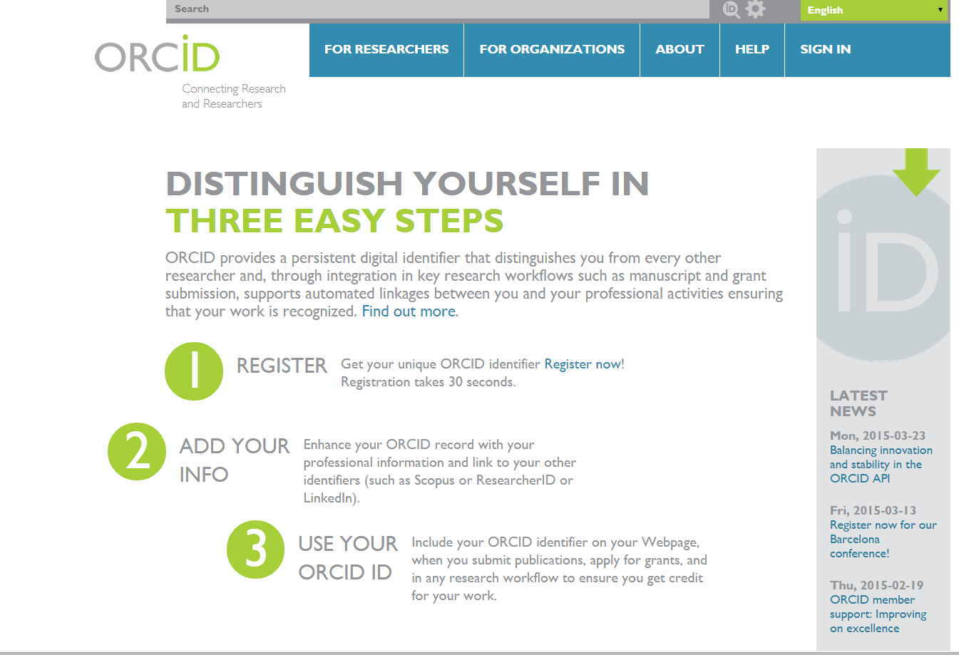
Additional information: Your ORCID iD and ANU anulib.anu.edu.au/howto

Slide 24
Writing a Data Management Plan
The Australian National University is a participating institution of the DMPTool service* ANU recommends the use of the default DMPTool template.
To complete a plan, you will need to consider the following:
Data Collection
What data will you collect or create?
How will the data be collected or created?
Documentation and Metadata
What documentation and metadata will accompany the data?
Ethics and Legal Compliance
How will you manage any ethical issues?
How will you manage copyright and Intellectual Property Rights issues?
Storage and Backup
How will the data be stored and backed up during the research?
How will you manage access and security?
Selection and Preservation
Which data are of long-term value and should be retained, shared, and/or preserved?
What is the long-term preservation plan for the dataset?
Data Sharing
How will you share the data?
Are any restrictions on data sharing required?
Responsibilities and Resources
Who will be responsible for data management?
What resources will you require to deliver your plan?
*provided by the California Curation Centre of the California Digital Library

Slide 25
Data Management Plan
From 2020 ARC will require that data management plans are in place prior to the commencement of the project.
arc.gov.au/research-data-management
ANU recommends DMPTool: dmptool.org
Using DMPTool to create a plan
Video 1 - youtu.be/90x6QRpehQw
Video 2 - youtu.be/VBRuCC7y1no

Slide 26
Metadata
Metadata is "data that provides information about other data"
Descriptive
- What is it about?
- Title, time, author, keywords
- Relations to other data objects
Administrative (Access & Rights)
- Ownership and use permissions
Provenance
- Where does it come from?
- History of changes to the data, versions
Standards/Schemas

Slide 27
Example of Metadata
Records from Research Data Australia:
researchdata.ands.org.au/measuring-effects-human-leptonychotes-weddellii/640511
A record from OpenResearch@ANU
openresearch-repository.anu.edu.au/handle/1885/138114?mode=full
The Pacific and Regional Archive for Digital Sources in Endangered Cultures (PARADISEC) paradisec.org.au/deposit/metadata/

Slide 28
Resources
LibGuide Data Management: ql.anu.edu.au/data
ANU Research Data Management Manual ql.anu.edu.au/cco9
ARDC: ardc.edu.au
RE3Data.org: re3data.org
ANU Research data management resources:
anulib.anu.edu.au/research-learn/research-data-management
Artificial Intelligence including generative AI: https://libguides.anu.edu.au/c.php?g=960102&p=6969710
ANU Talk data to me: anulib.anu.edu.au/publishing
Information on Sensitive Data Training : learning.cadre5safes.org.au
Data Repositories: journals.plos.org/plosone/s/data-availability
FAIR self-assessment tool: FAIR Data Self Assessment Tool
Google Dataset Search: datasetsearch.research.google.com/

Slide 29
Top Tips
Have a Data Management Plan
Back up your data
Register an ORCID

Slide 30
MOST IMPORTANT
BACK UP YOUR DATA
You can’t create a data management plan, share or reproduce your results if you have lost your data!

Slide 31
We love your feedback
repository.admin@anu.edu.au
zixiao.wang@anu.edu.au

Slide 32
Thank you
Contact Us
Digital Scholarship Team
Scholarly Information Services
T 02 6125 7928
E repository.admin@anu.edu.au
E zixiao.wang@anu.edu.au

