Slide 1
Managing your career

Slide 2
Personal Brand
Reputation versus personal brand
‘Your reputation is made up of the opinions and beliefs people form about you based on your collective actions and behaviours. [Credibility]
Your personal brand, on the other hand, is more intentional. It is how you want people to see you. [Visibility]’
Monarth, H, 2022 “What is the point of a personal brand” Harvard Business Review https://hbr.org/2022/02/whats-the-point-of-a-personal-brand

Slide 3
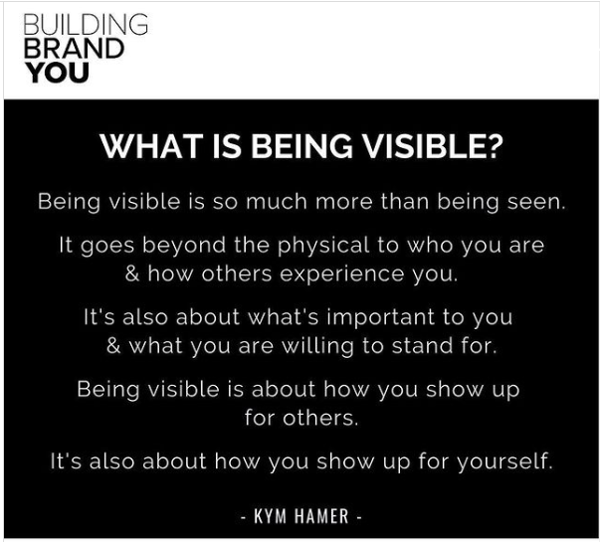
Visibility
Who are you talking to?
What are they interested in?
What are you amazing at?
What do you want to be seen as an expert in?
How do you want to be perceived?
Describe your brand in 3 words

Slide 4
Showing up
What do you want/need people to know about you?
How do you currently show up for yourself?
How do you WANT to show up for yourself?

Slide 5
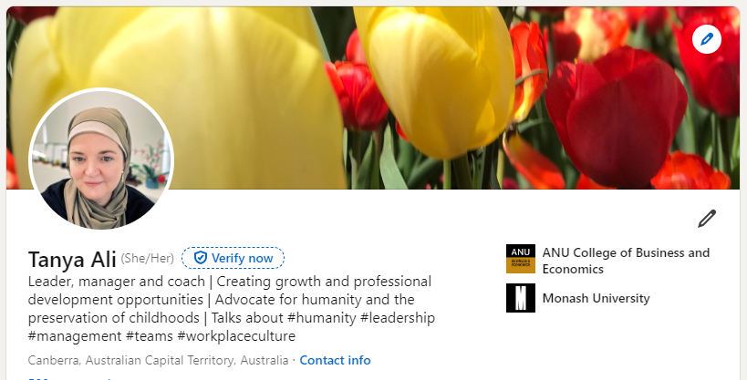

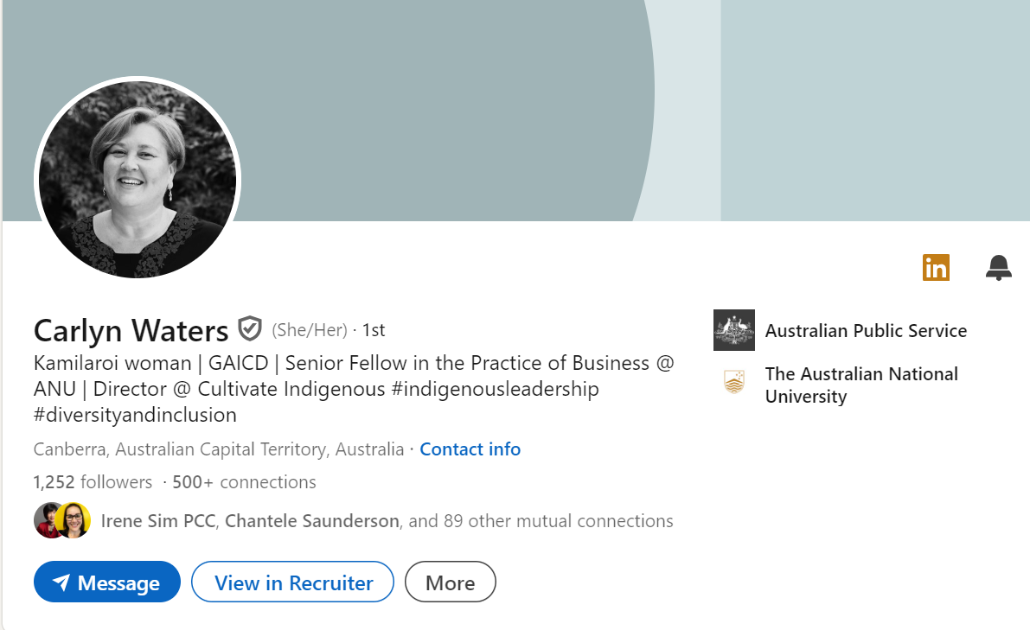
LinkedIn
Your profile photo
Customise your heading
Updating your contracts
Write an open letter to your target audience
Update your experience
Ask for recommendations

Slide 6
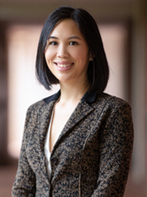



Profile photo
Create a photo that represents you
People with a photo get 9 times more connection requests
36 times more messages
21 times more profile views
Add, change, edit, or delete your LinkedIn profile photo | LinkedIn Help

Slide 7
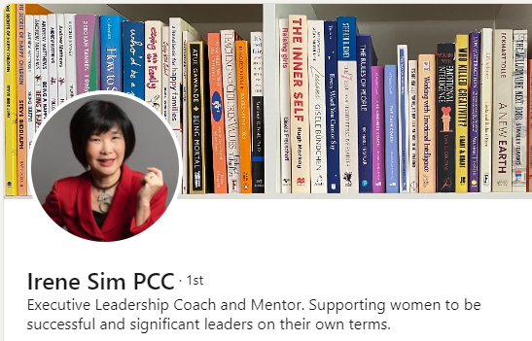
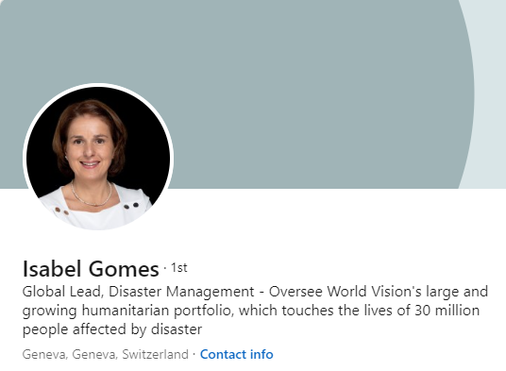
Headline more than your job title
Option 1:
Title and Company | Keyword 1 | Keyword 2 | Keyword 3
Option 2:
Keyword 1 | Keyword 2 | Keyword 3 | Keyword 4 | Keyword 5
Option 3:
Write a narrative on your skills, expertise, vision or role
HINT: Think about your target industry key words, your unique skill set, investigate and learn from leaders and influences in your focus area.

Slide 8
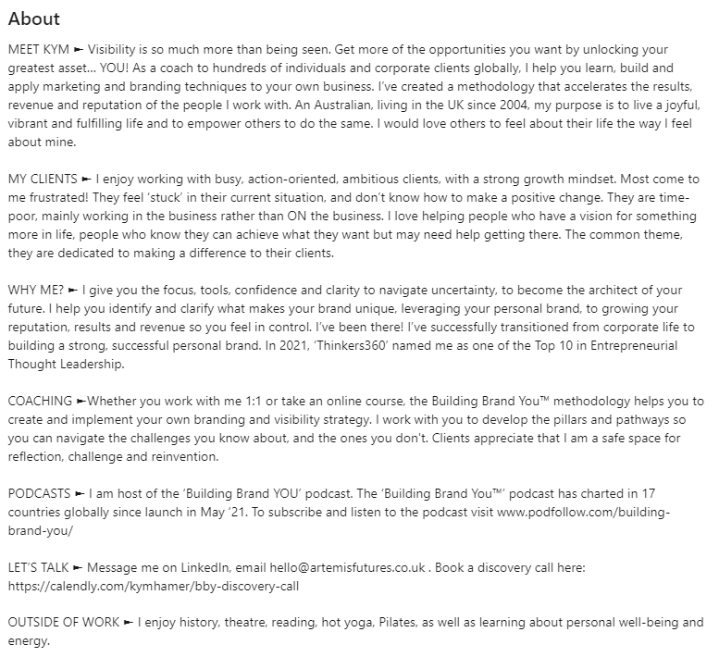
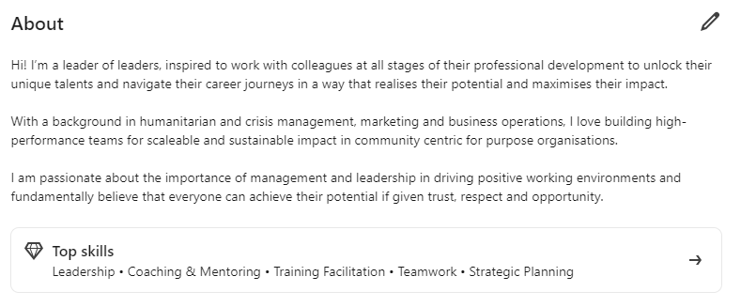
About: your who, what, how and why

Slide 9
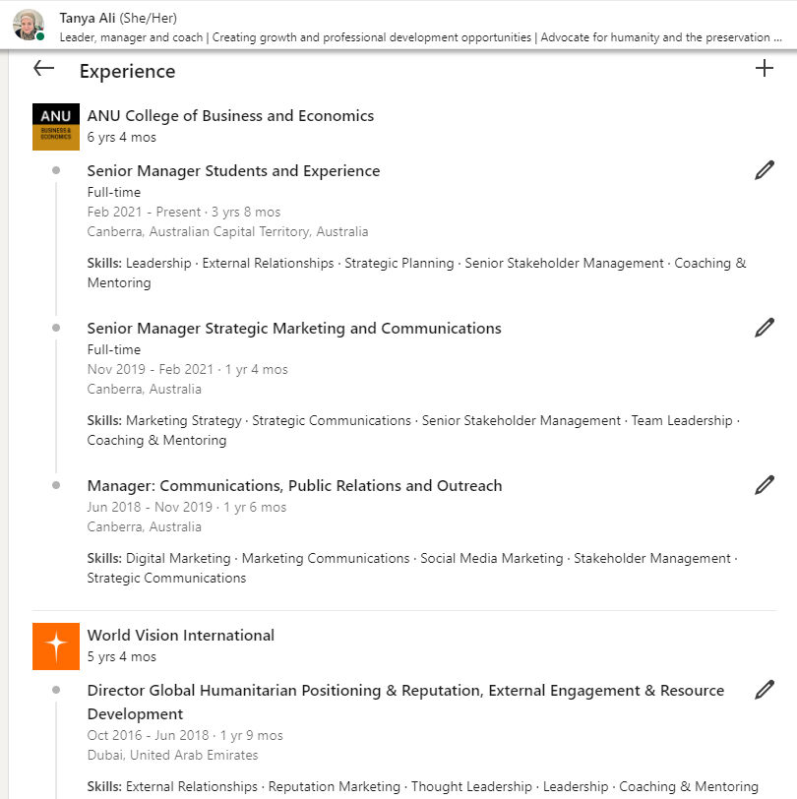
Update your experience

Slide 10
Managing your personal brand
Tone – consistent, fact-led, authentic
Insight – value, perspective, or angle you can bring
Responding to others – respectful, polite
Interest – does this content generate interest, demand, does it meet its objective

