Slide 1
SELT promotional slides
Images to be displayed any time during Semester 2 SELT window
21 October – 17 November 2024
Slide deck features different options for SELT promotion, please choose one or more slides according to your preference
Materials prepared by the Institutional Research team in collaboration with the Centre for Learning & Teaching

Slide 2





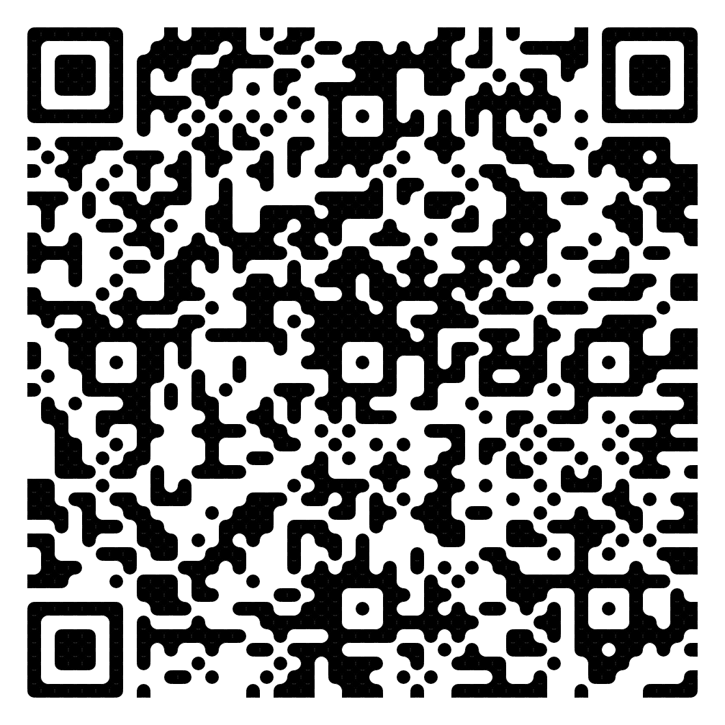
The SELT survey journey
The Student Experience of Learning & Teaching survey allows students to give feedback on their courses and teachers. It is voluntary and confidential, and run by the Institutional Research (IR) team.
Survey opens – links are emailed to students and also available in Wattle
After grade release, SELT feedback is made available to teachers and course convenors to improve future course delivery
In the meantime, grades are released to students
Survey closes – Institutional Research team screen comments for wellbeing concerns
Students provide constructive and respectful feedback (your teacher can’t identify you)
Find out more on the Info for Students webpage:
https://services.anu.edu.au/learning-teaching/education-data/student-experience-of-learning-teaching-selt/information-for-students

Slide 3
The SELT survey journey – Semester 2
The Student Experience of Learning & Teaching survey allows students to give feedback on their courses and teachers. It is voluntary and confidential, and run by the Institutional Research (IR) team.
17 November - Survey closes
Survey closes – Institutional Research team screen comments for wellbeing concerns
9 December
After grade release, SELT feedback is made available to teachers and course convenors to improve future course delivery
21 October – Survey opens
Links are emailed to students and also available in Wattle
Survey runs for 4 weeks
Students provide constructive and respectful feedback (your teacher can’t identify you)
28 November
Grades are released to students
Find out more on the Info for Students webpage:
https://services.anu.edu.au/learning-teaching/education-data/student-experience-of-learning-teaching-selt/information-for-students

Slide 4

SELT is live!
Leave your mark
The Student Experience of Learning & Teaching survey is open from 21 October to 17 November
Your feedback helps to shape the student experience at ANU
Check your ANU email inbox or Wattle dashboard to take part

Slide 5



SELT is live!
Get your ducks in a row and make sure your voice is heard
Student Experience of Learning & Teaching (SELT) feedback helps drive improvement in student experience across all ANU
The survey runs from 21 October – 17 November

Slide 6



The Student Experience of Learning & Teaching (SELT) survey
What kind of feedback is helpful?
Think about your experience of the course and teaching, and what worked or didn’t work for you.
When writing feedback, focus on respectful, constructive and specific language – if you were a teacher, what type of feedback would help you improve the class?

Slide 7

The Student Experience of Learning & Teaching (SELT) survey
Can teachers see who left specific comments?
No. SELT is confidential, and teachers cannot see, or ask to see, the identity of a respondent. Unless you self-identify, for example by using names or describing specific events, teachers cannot identify you.
If your class has very few enrolments, it may be difficult to remain completely anonymous.
Please be respectful and constructive in your feedback.

Slide 8

The Student Experience of Learning & Teaching (SELT) survey
Why is SELT important?
SELT feedback is used by the University to improve the delivery of courses. It lets us see what is working and what may need some changes from the student perspective.
Teachers use their feedback for personal development as well as use in professional promotion. Shout out a job well done, or share suggestions for a better student experience.
Feedback is a great way to pay it forward for future students, with your suggestions shaping the next course delivery.

